Slide 1
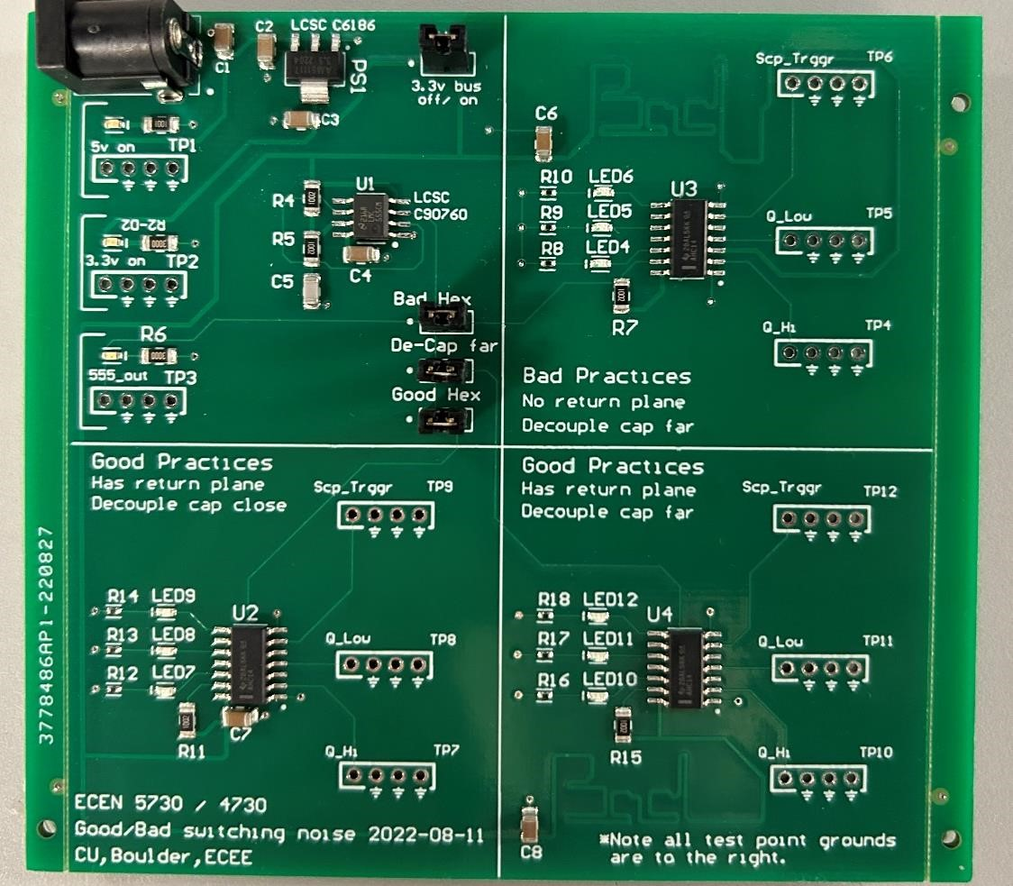
Lab 15 Findings
Joseph Abroquah
Data Collected: 10/03/2025
Goal: Compare 3 identical circuits but with different layouts rules to quantify the impacts of decoupling and return plane design rules
Quality Metric: Compare the rise/fall times as well as the rail collapse of each of the three blocks
  Good = Close decoupling, solid return plane
  Bad Cap = Far decoupling, solid return plane
  Bad Bad = Far decoupling, no return plane
555 clock
Bad Bad
Good
Bad Cap

Slide 2
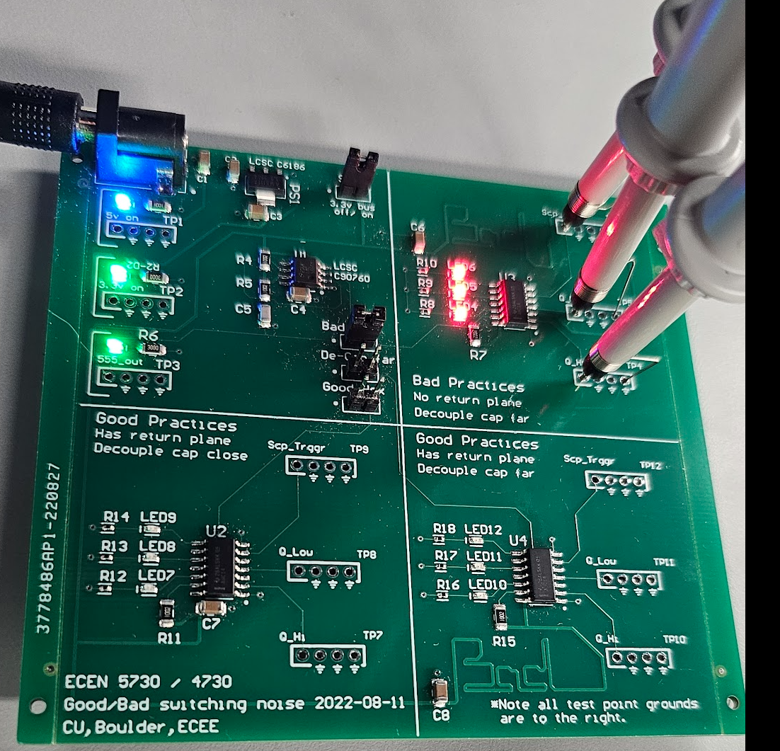
Key Findings
Data collection during clock switching
  Rise time
  Fall time
  Peak – Peak value
Performance comparison between different design practices in terms of collected data was carried out and result is shown on next slide
Key Message: Identical circuit designs perform badly when good design practices are violated

Slide 3
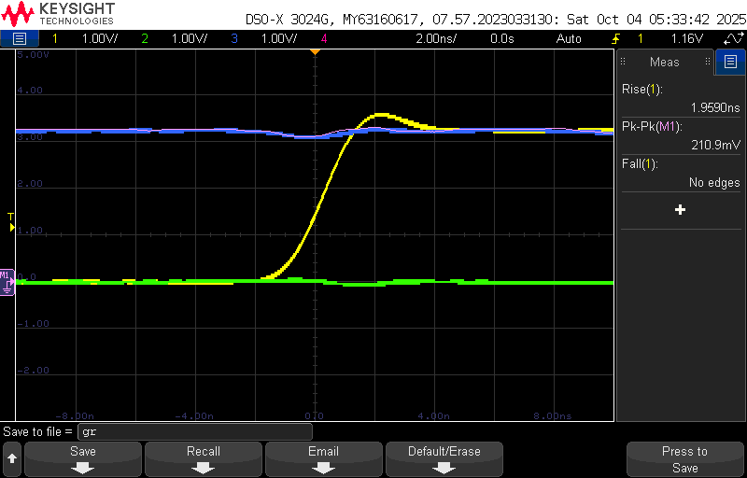
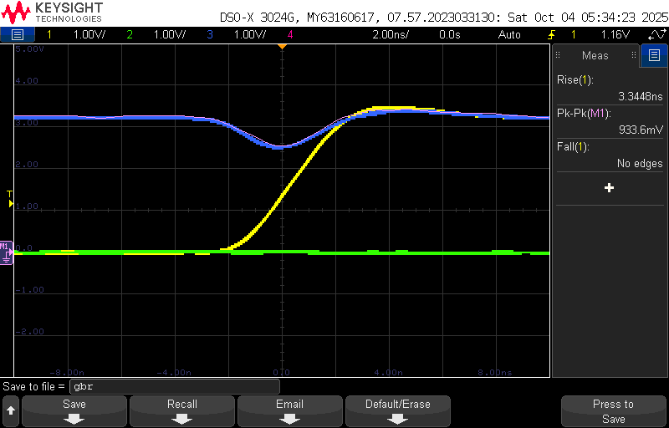
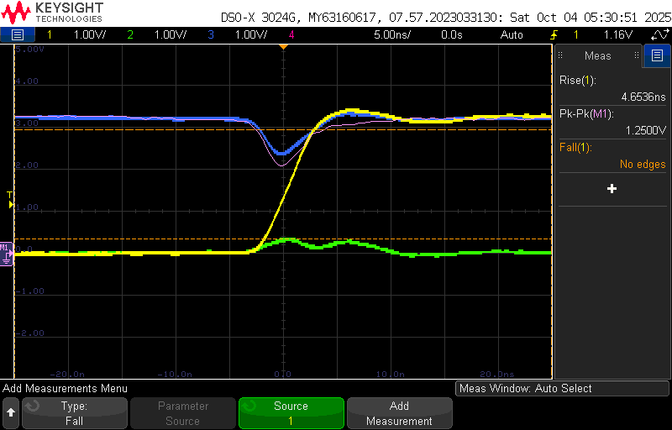
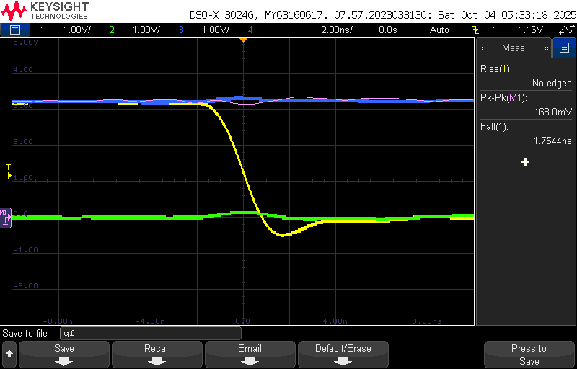
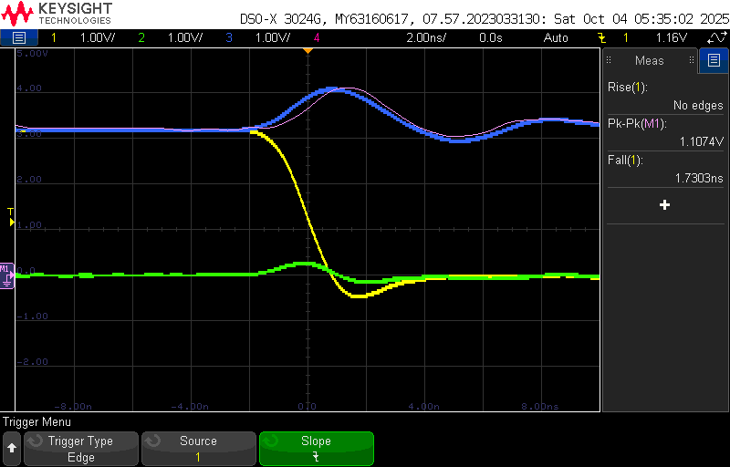
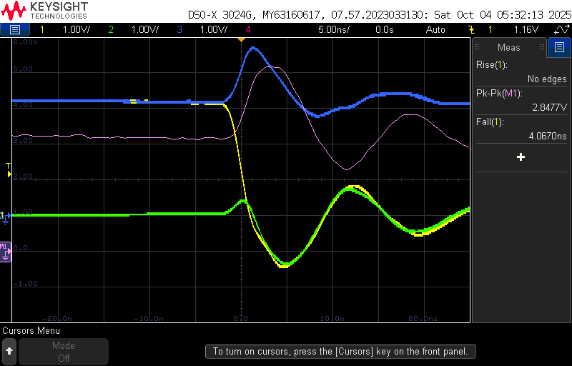
555 clock
Bad Bad
Rising Edge |  | Falling Edge
RT (ns) | P2P (mV) | FT (ns) | P2P (mV)
1.96 | 210.9 | 1.75 | 168
555 clock
Bad Bad
Rising Edge |  | Falling Edge
RT (ns) | P2P (mV) | FT (ns) | P2P (mV)
3.34 | 933.6 | 1.73 | 1107
555 clock
Bad Bad
Rising Edge |  | Falling Edge
RT (ns) | P2P (mV) | FT (ns) | P2P (mV)
4.65 | 1250 | 4.07 | 2848
Good
Bad Cap
Good
Bad Cap
Good
Bad Cap
Rising Edge: 1.7 x slower, 4.4x rail collapse!
Rising Edge: 2.4x slower, 5.9x rail collapse!
Falling Edge: 0.99x slower, 6.6x rail collapse!
Falling Edge: 2.3xslower, 17x rail collapse!
Good Rising Edge
Bad Cap Rising Edge
Bad Bad Rising Edge
Good Falling Edge
Bad Cap Falling Edge
Bad Bad Falling Edge

